Slide 1




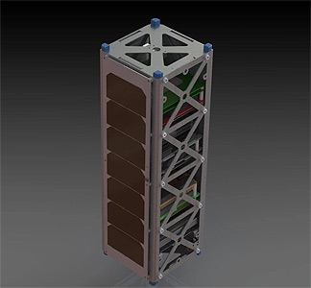
EagleSat-2
Attitude Determination/Control System:
Monitoring and Management
Logan Ruddick
BS Aerospace Engineering, Astronautics, Dec. 2024
Embry-Riddle Aeronauical University, Prescott, AZ
Dr. Ahmed Sulyman
Associate Professor of Electrical Engineering
College of Engineering
Embry-Riddle Aeronautical University, Prescott, AZ
EagleSat-2 | Rendering

Slide 2

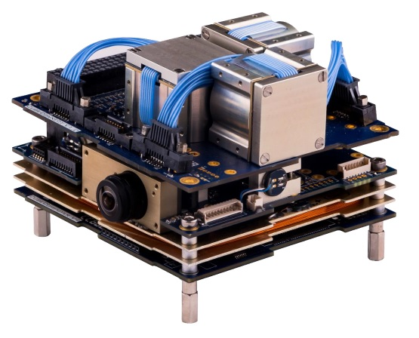
Background: ADCS
Attitude Determination and Control System
Local control of angular momentum
Position and Orientation
Magnetorquers and Reaction Wheels
Telemetry Logging
Detumbling
Independent Function and Error Handling
To an extent…
CubeADCS Gen 1 |CubeSpace Satellite Systems
Notes:
Discuss the role and capabilities
Discuss its importance on the satellite
Discuss the importance of redundancy because of this role

Slide 3
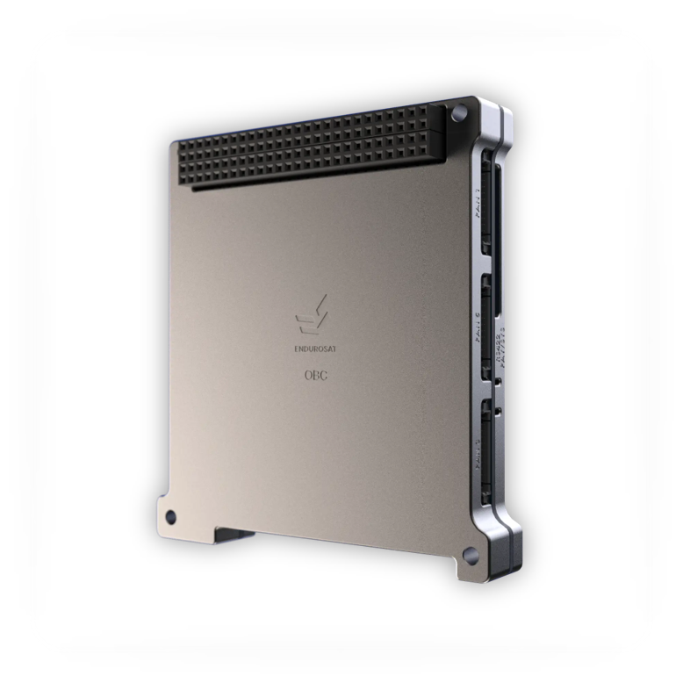
The Ideal: ADCS State Manager
Monitor and Log errors reported by the OBC
Take action as needed to correct errors
Intelligently override the logic of ADCS in Emergencies
Perform necessarily well, but not replace the ADCS Logic at all times
OBC: ARM Cortex-M7|Endurosat AD
Notes:
Redundancy in the form of a State manager

Slide 4
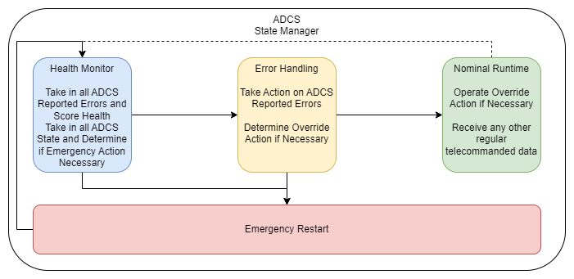
The Design: ADCS State Manager
Notes:
This is the general plan
Isolated process that gets automatically restarted by the taskmanager

Slide 5

The Solution: ADCS State Manager
Health Monitor
Reported errors “Sickness” Score.
If errors are too severe, immediately order a restart
Determine if appropriate runmode is detected.
Error Handling
Perform action on detected errors
Examine for change in error status
Nominal Runtime
Operate runmode override as necessary
Perform various miscellaneous tasks (ex. Status logging)
Notes:
Run through the general logic of the ADCS SM (3 mins)

Slide 6
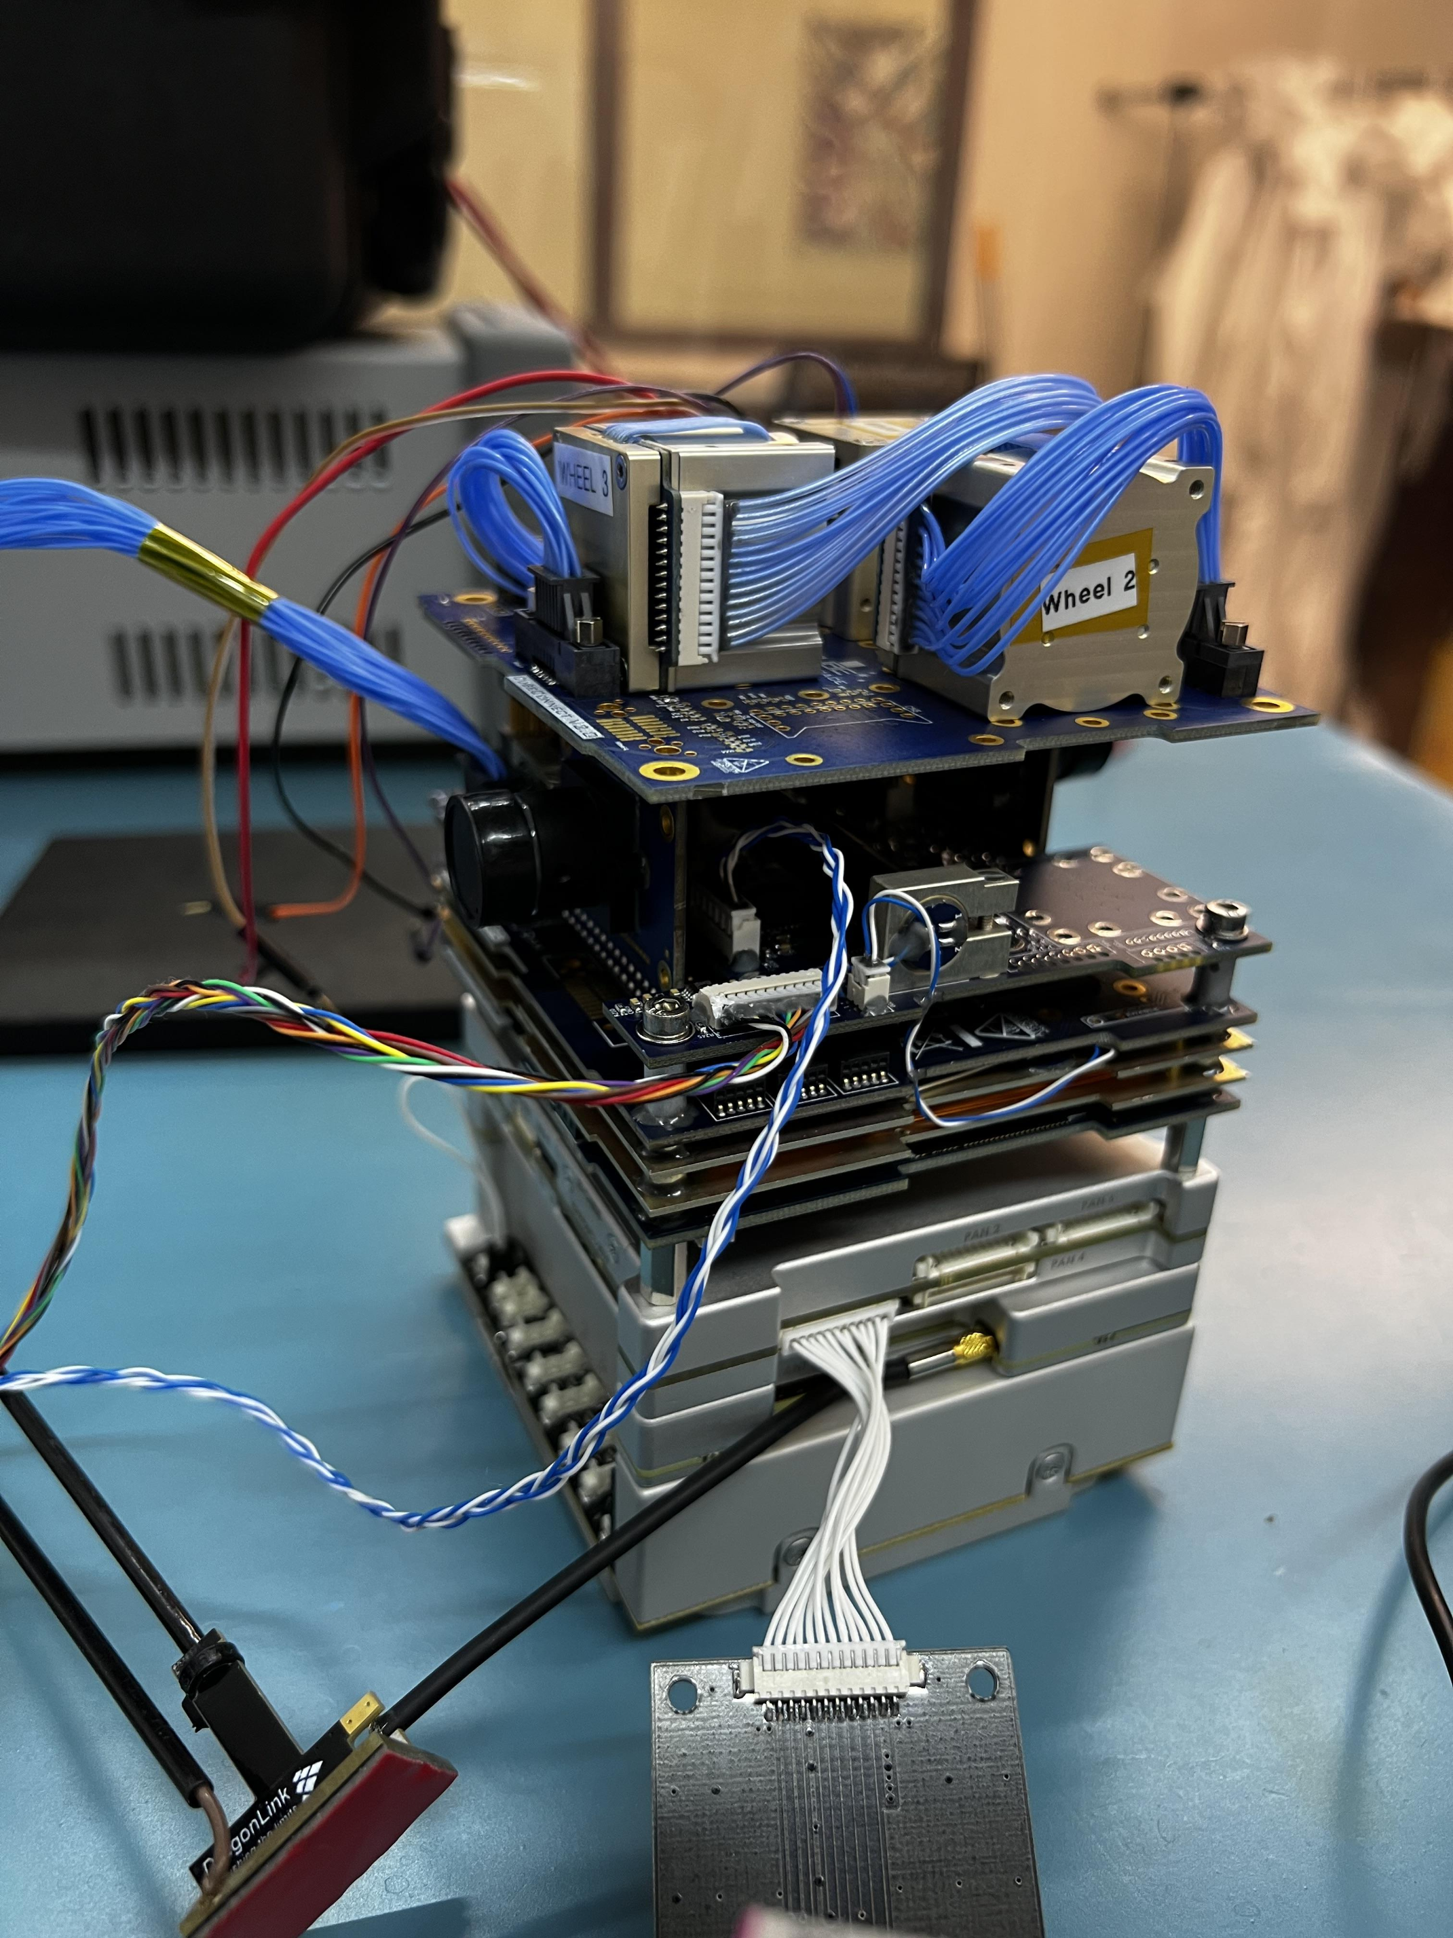
The Flaw: Systemic Failure
Power Failure
OBC Failure
State Manager Process Crash
OBC Crash
OBC Failure
ADCS Failure
EPS+OBC+UHF+ADCS Stack | EagleSat-2
Notes:
Discuss potential failure cases, the recovery strategy (if any) and the likelihood

Slide 7
Status: ADCS State Manager
April 7th, 2023:
State Manager in development
Health Monitor Completed
Error Checking In Progress
Nominal Runtime Designed
Restart Logic In Progress
Goal: Completed April 30th, 2023
EPS+OBC+UHF+ADCS Stack | EagleSat-2
Notes:
Discuss potential failure cases, the recovery strategy (if any) and the likelihood

